Slide 1
EE215A: Router
An Lihua, Gong Yutao

Slide 2
CONTENT
PART 1
Basic Algorithm
PART 2
Optimization
PART 3
Results

Slide 3
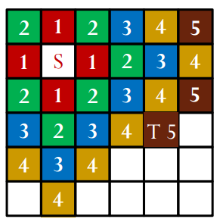
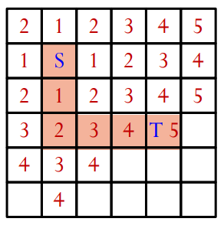
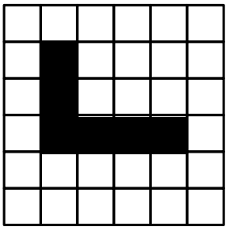

Basic Algorithm
Maze Router:
Expand
Backtrace
Clean up
Use queue: first in first out
Expanded in pathcost order, cheapest cells before more expensive cells.
Up
Down
3

Slide 4
Basic Algorithm
Result is not good …
 | Accuracy | Cost
bench1 | 20/20 | 352
bench2 | 20/20 | 3110
bench3 | 16/16 | 1279
bench4 | 15/15 | 1793
bench5 | 86/128 | 9433
fract2 | 109/125 | 12142
primary1 | 679/830 | 169094
industry1 | 839/1000 | 572584
4

Slide 5
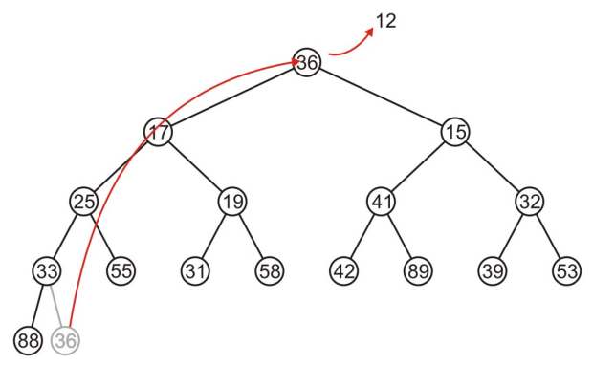
Optimization
Algorithm
Cheapest-cell-first search: Dijkstra’s algorithm
Predecessor: record the direction of reached
Take into account of the Bend/Via Penalty when finding the cheapest pathcost
Data Structure: Min Heap
5

Slide 6
Optimization
Net Order
1
2
Sorted all the nets by pins’distance
Connect the shorter nets first
……
2
1
6

Slide 7
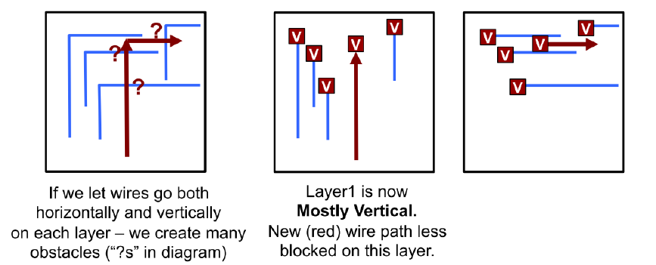
Optimization
Preferred Routing Directions
If failed, route again without any restriction
7

Slide 8
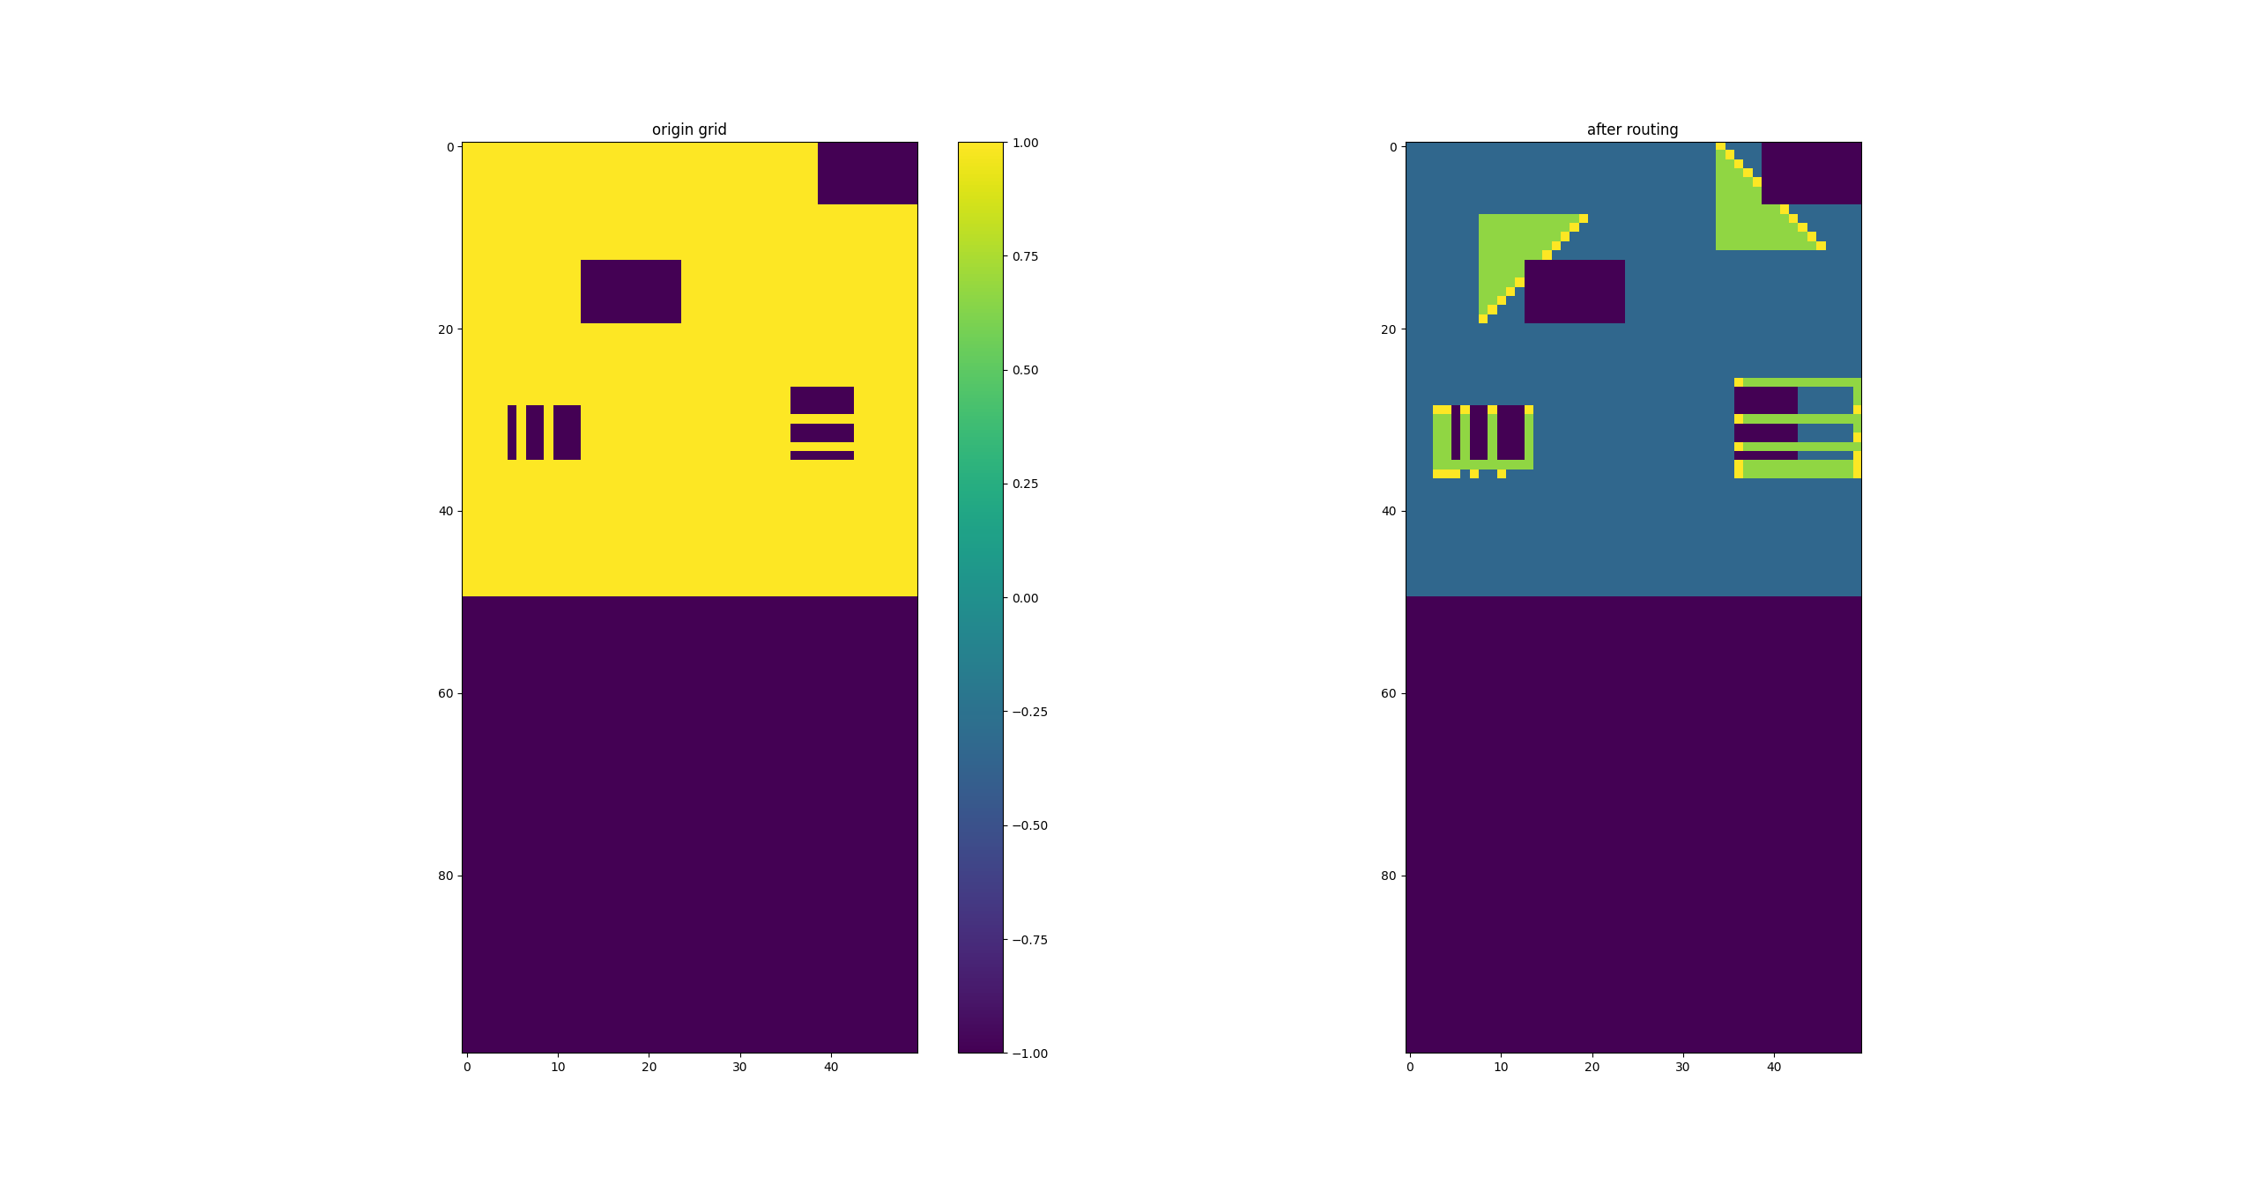

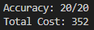
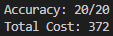
Results
bench1
grid
basic algorithm
opt
8

Slide 9
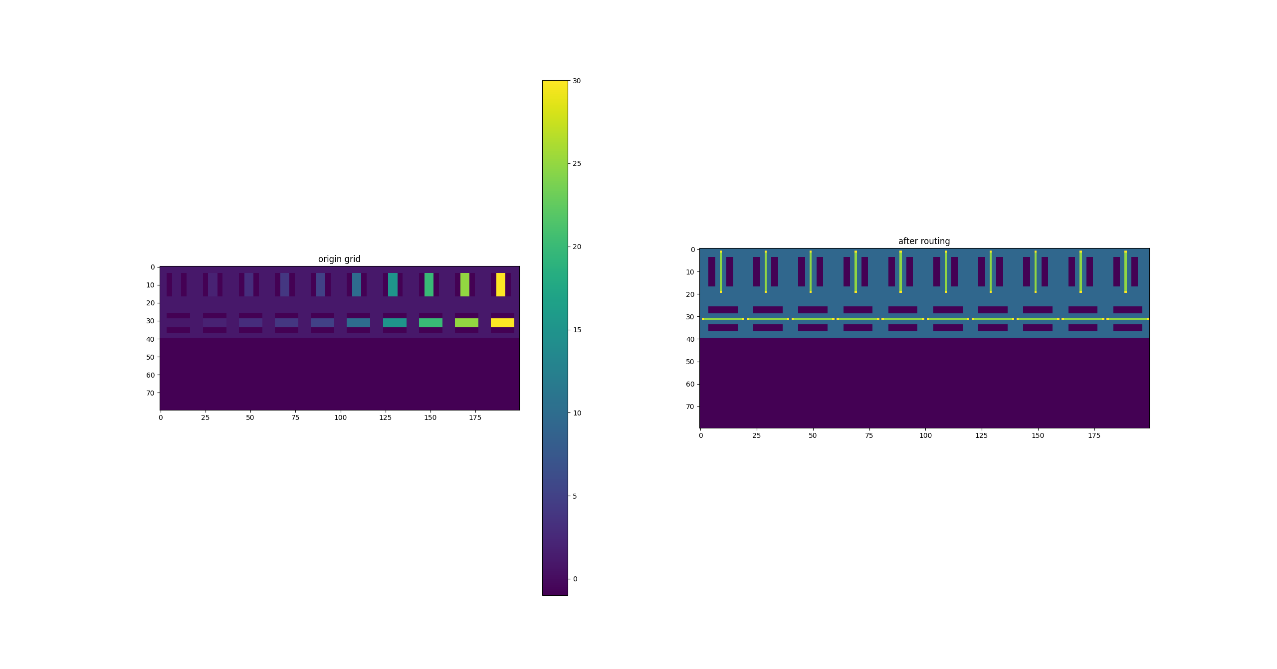

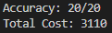
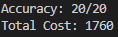
Results
bench2
grid
basic algorithm
opt
9

Slide 10
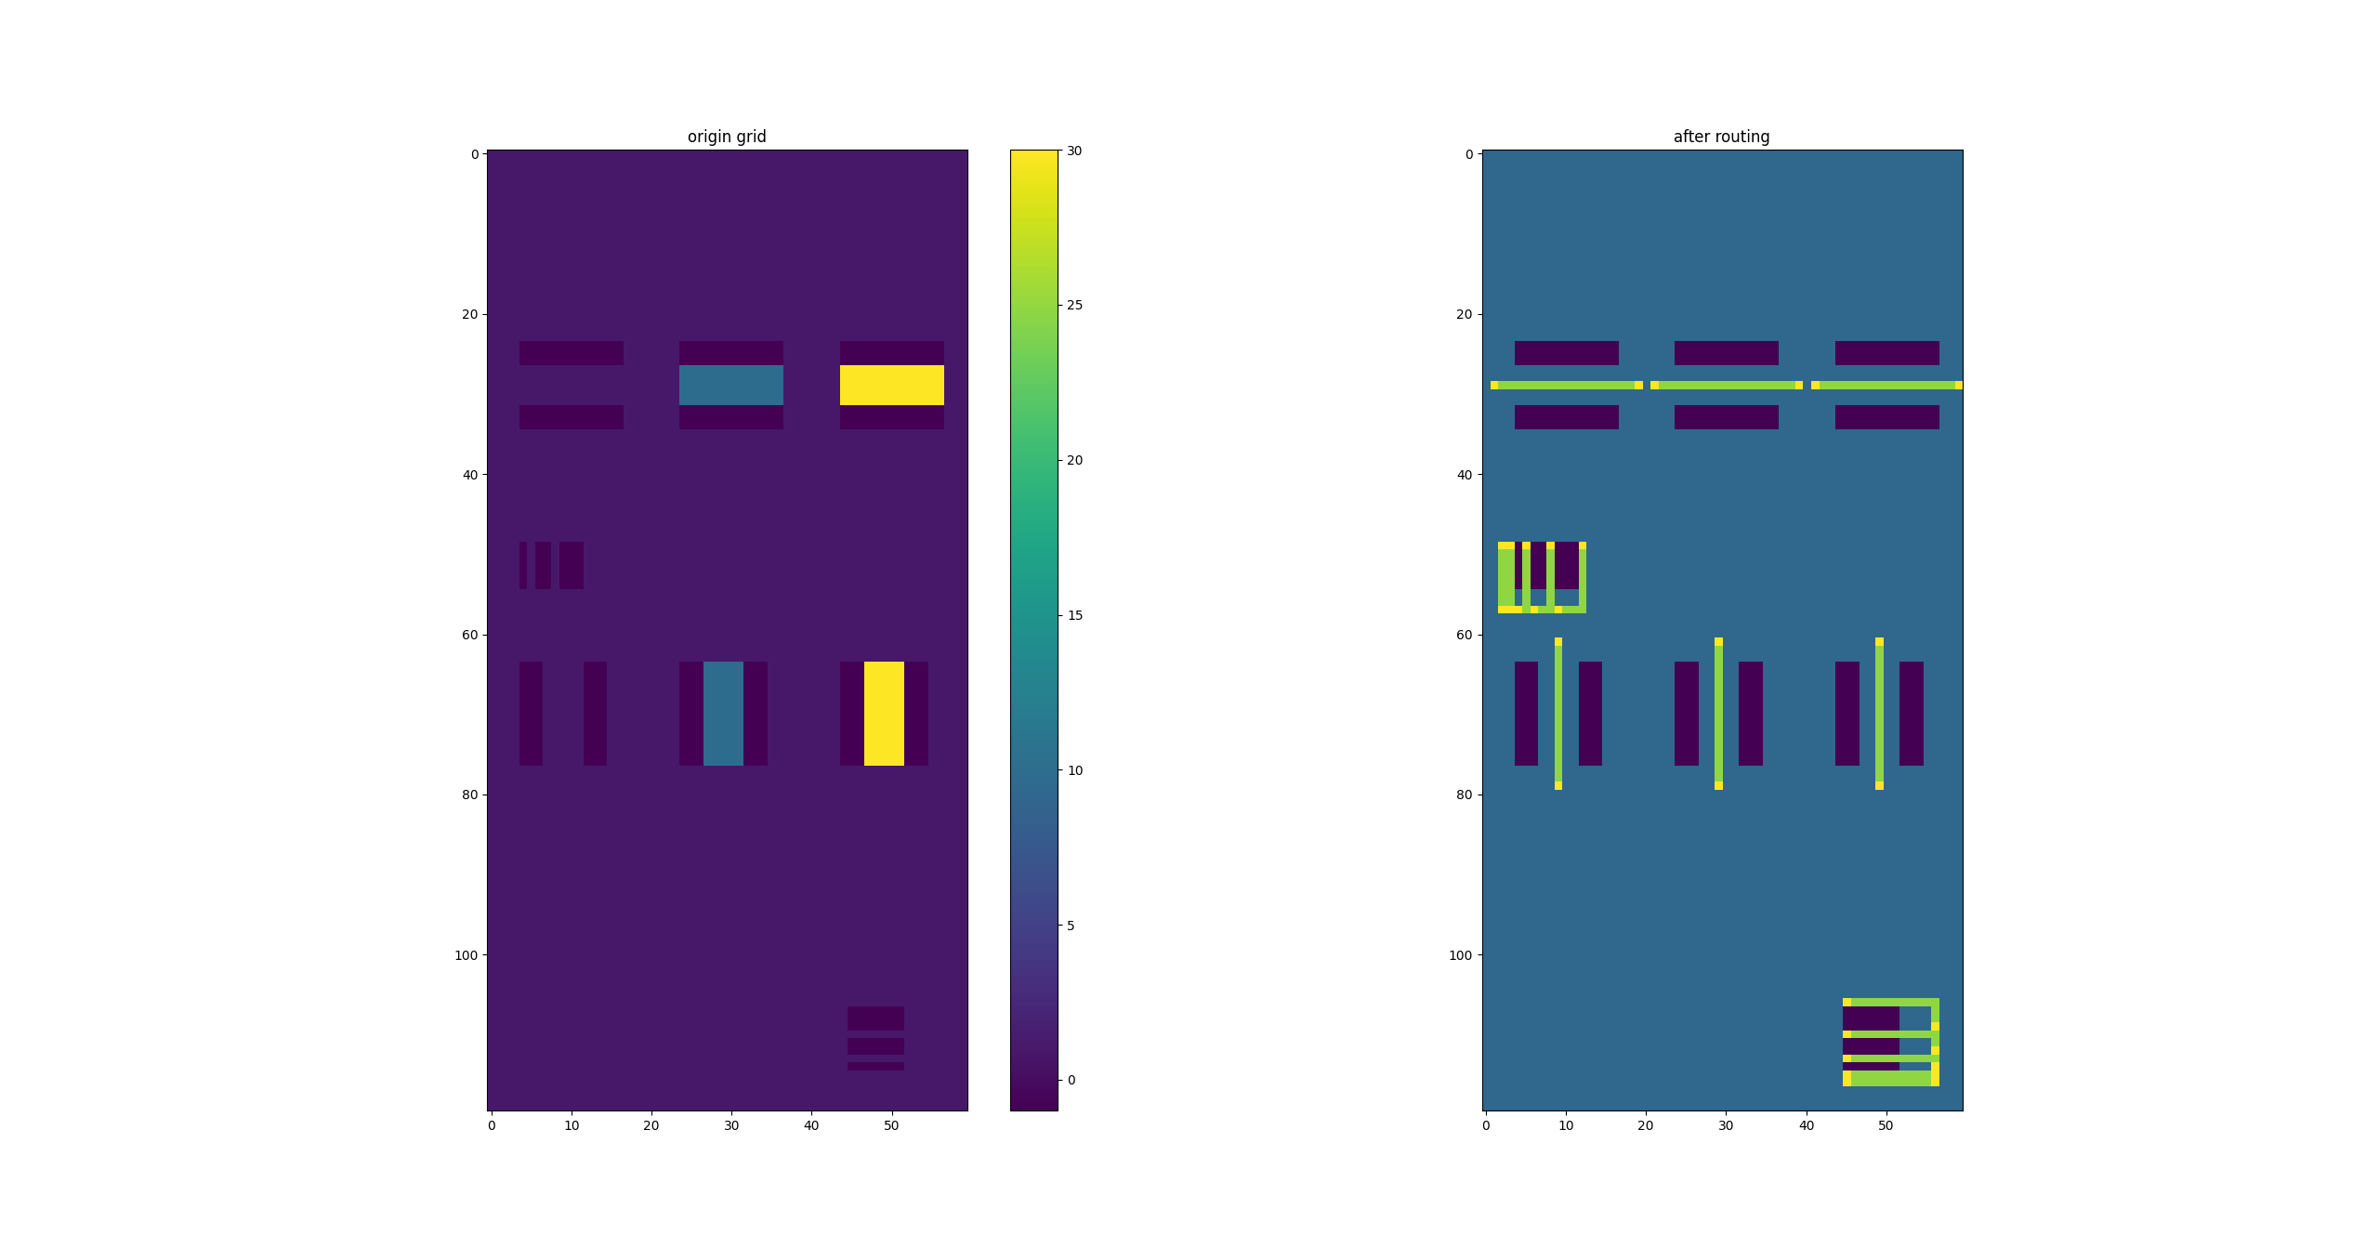
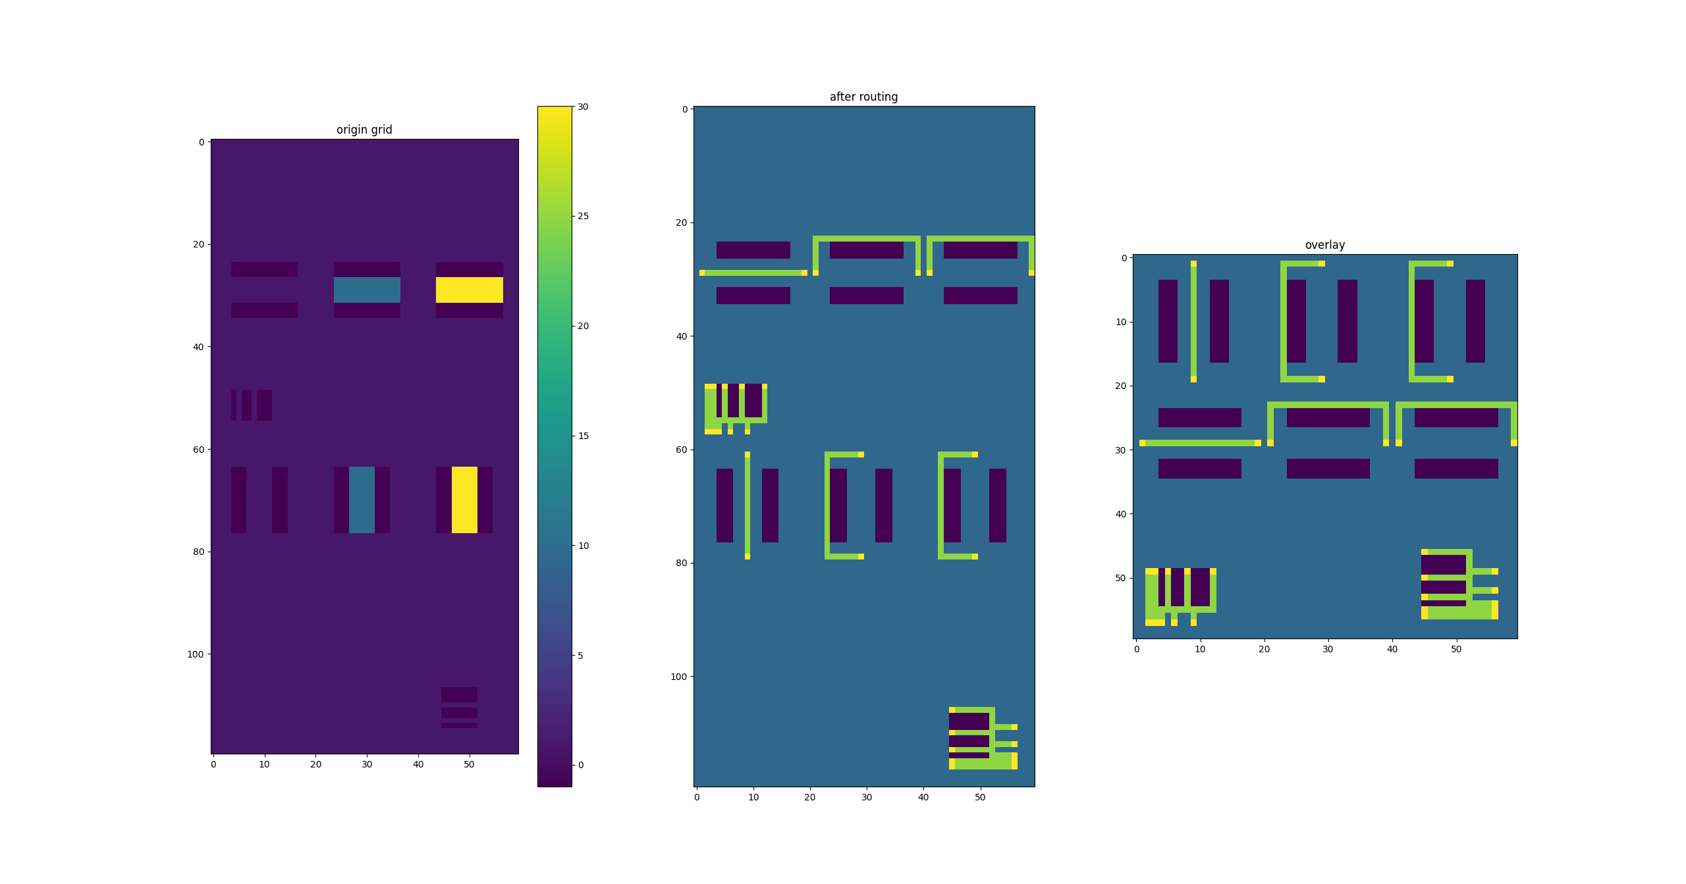
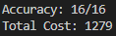
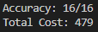
Results
bench3
grid
basic algorithm
opt
overlay
10

Slide 11
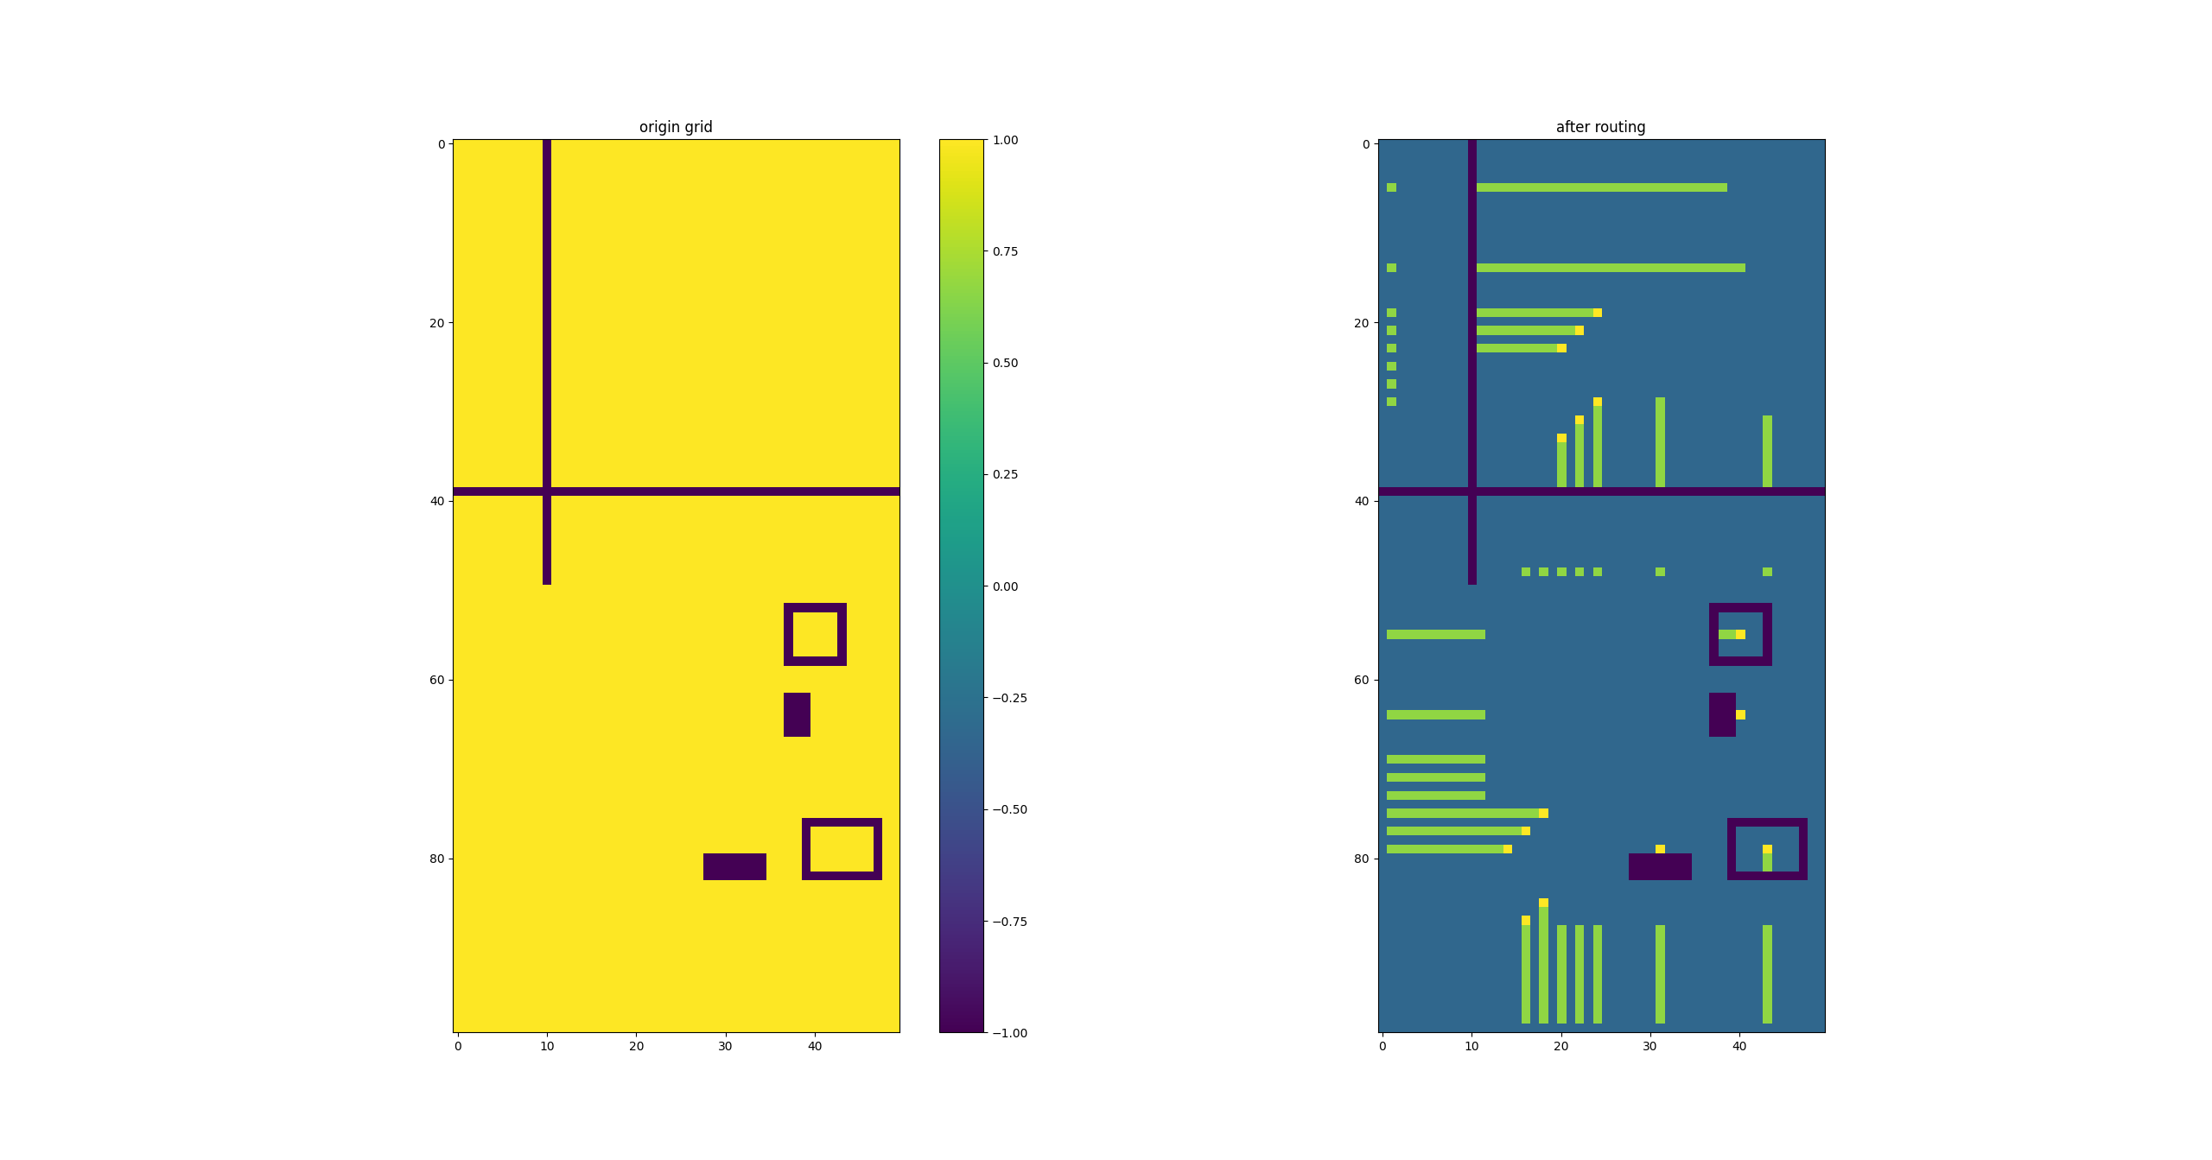
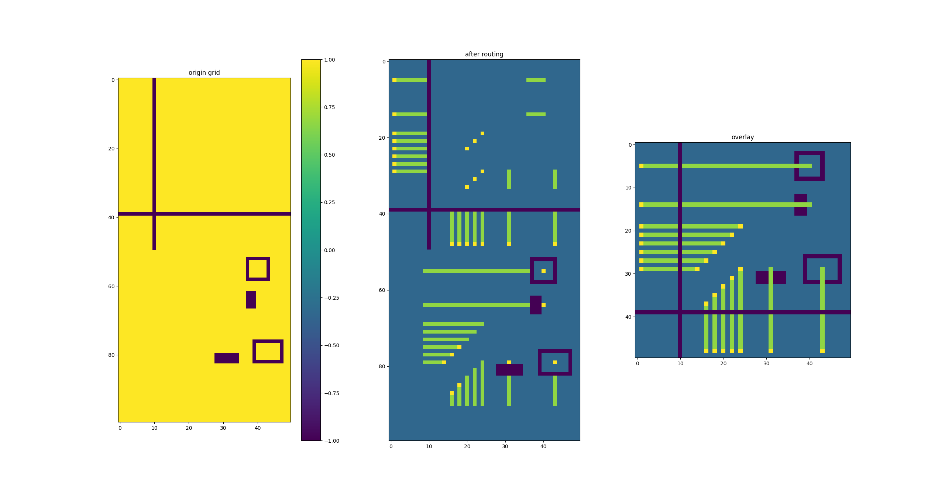
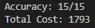
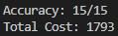
Results
bench4
grid
basic algorithm
opt
overlay
11

Slide 12
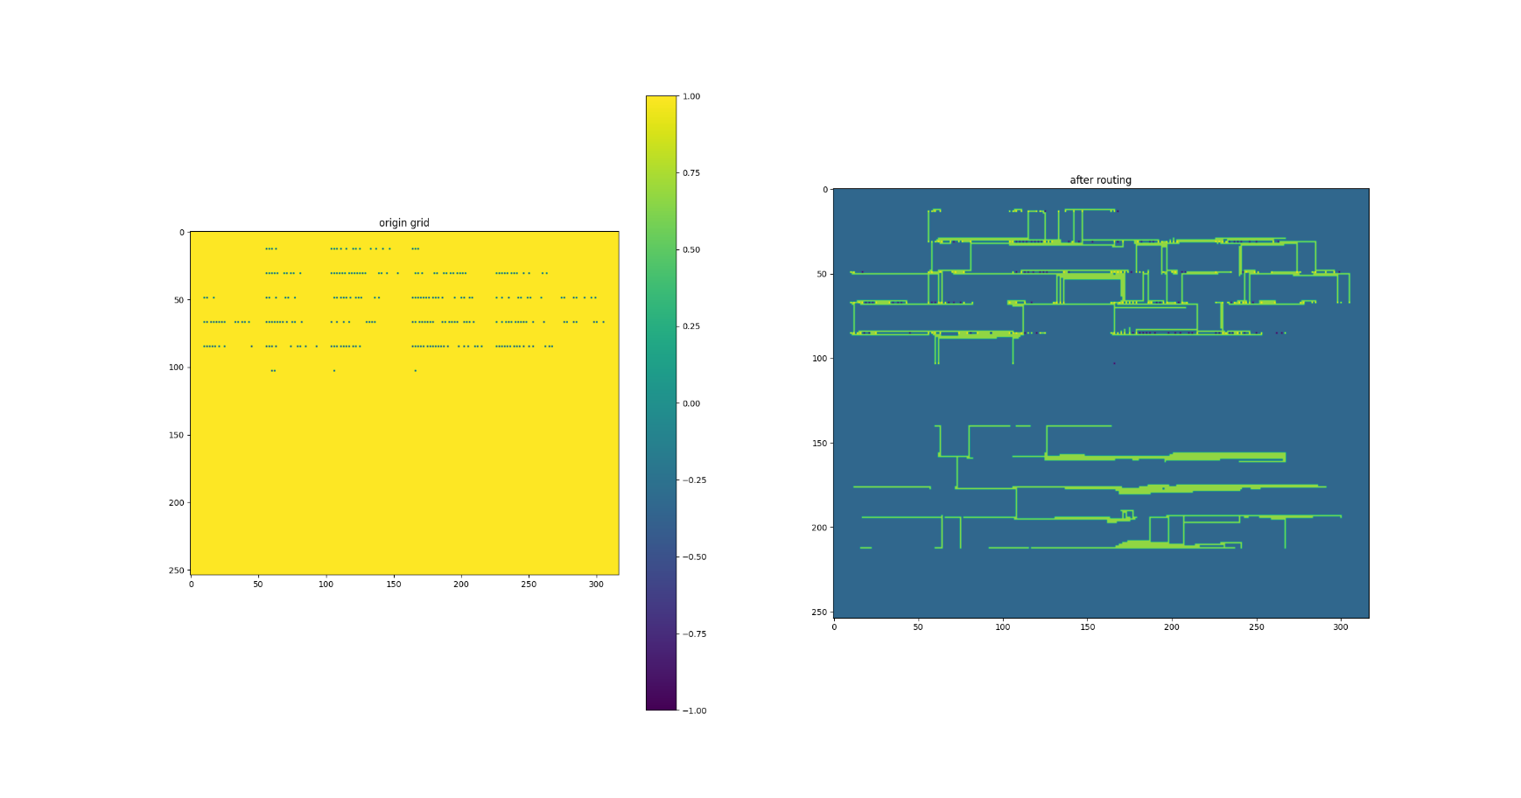
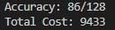
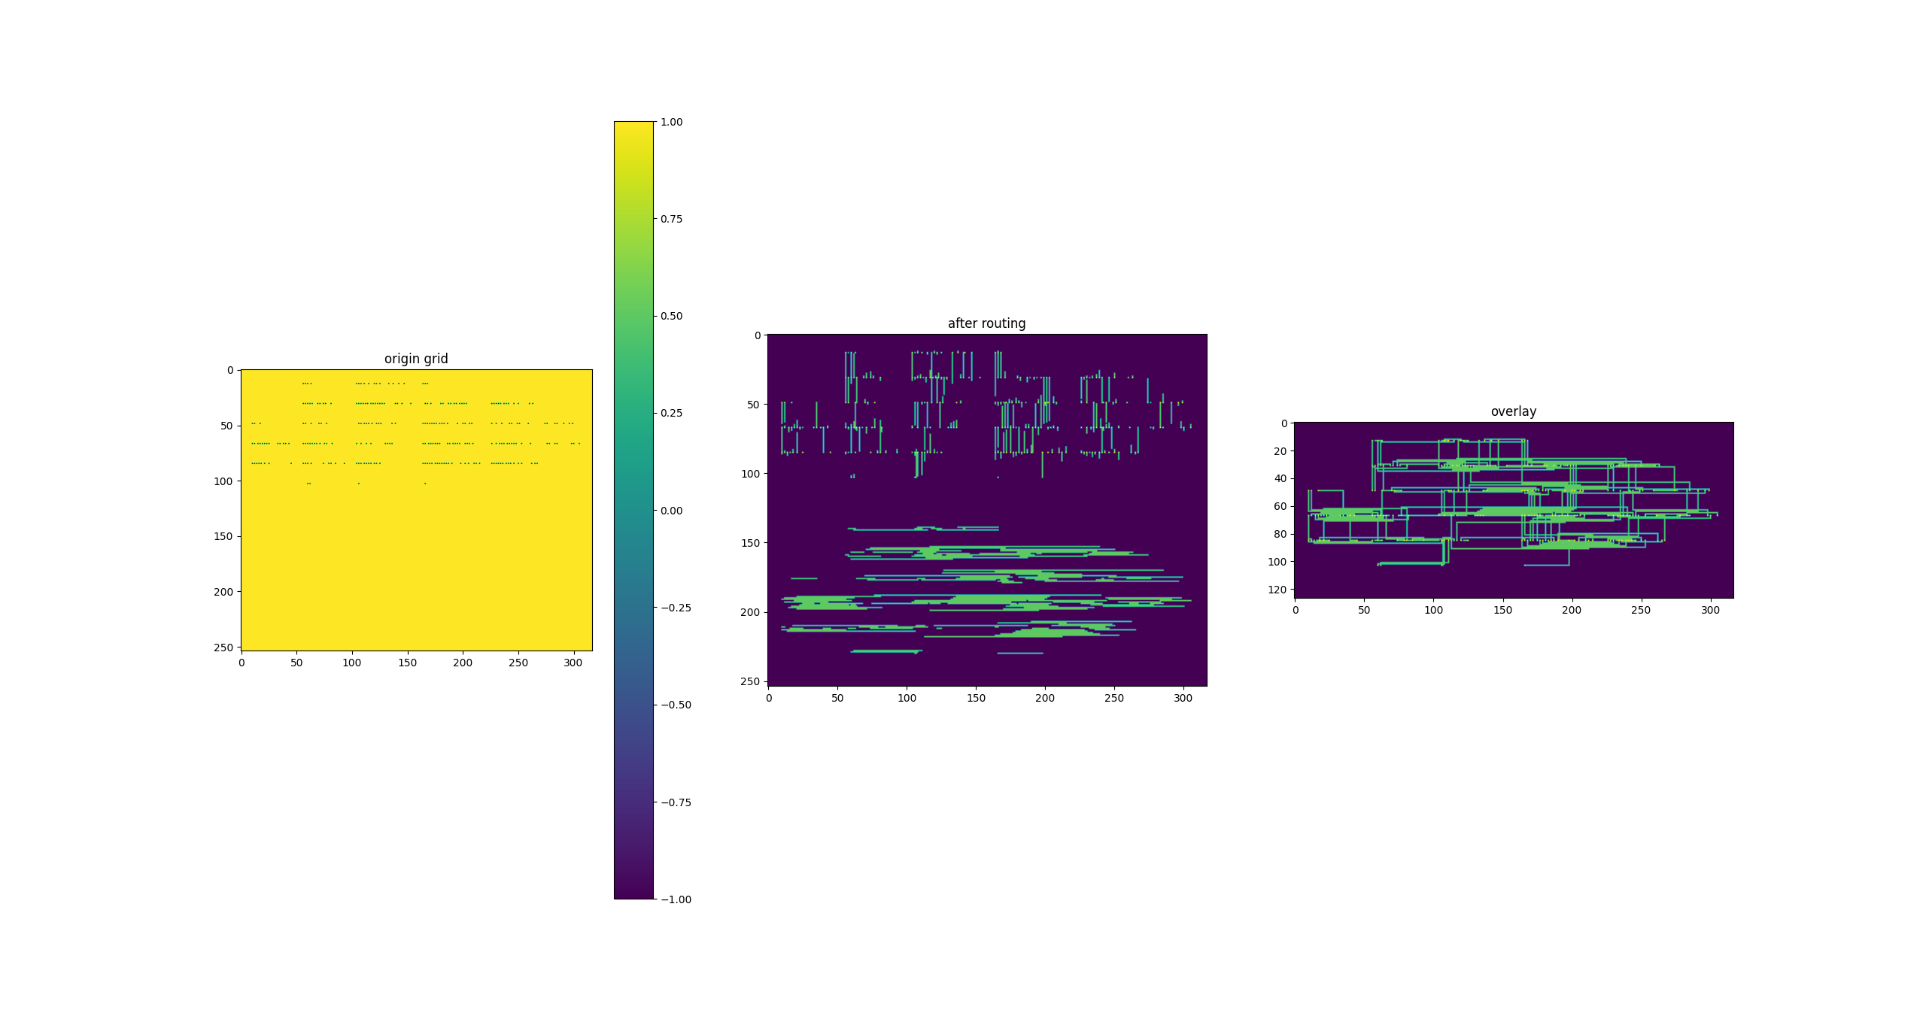
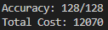
Results
bench5
grid
basic algorithm
opt
overlay
12

Slide 13
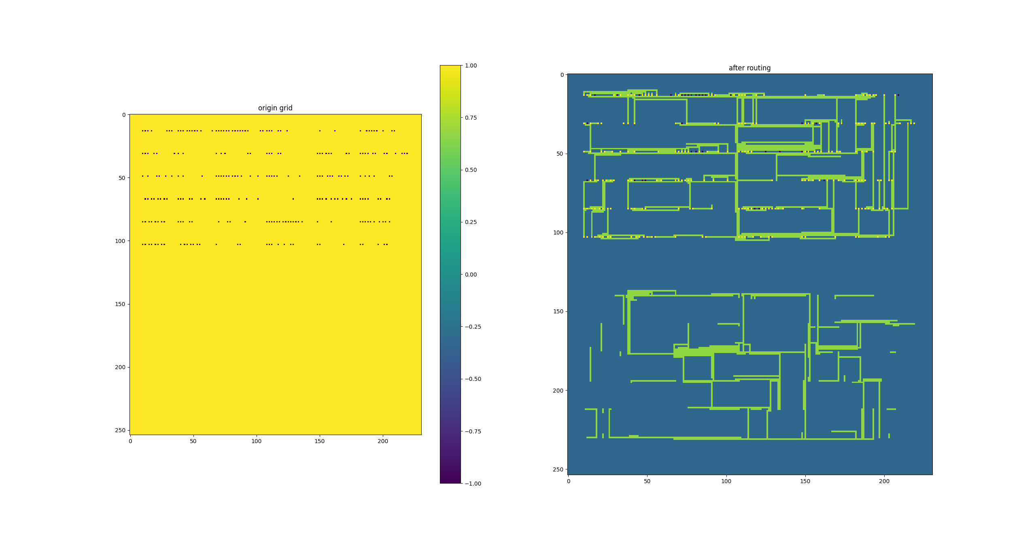
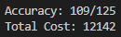
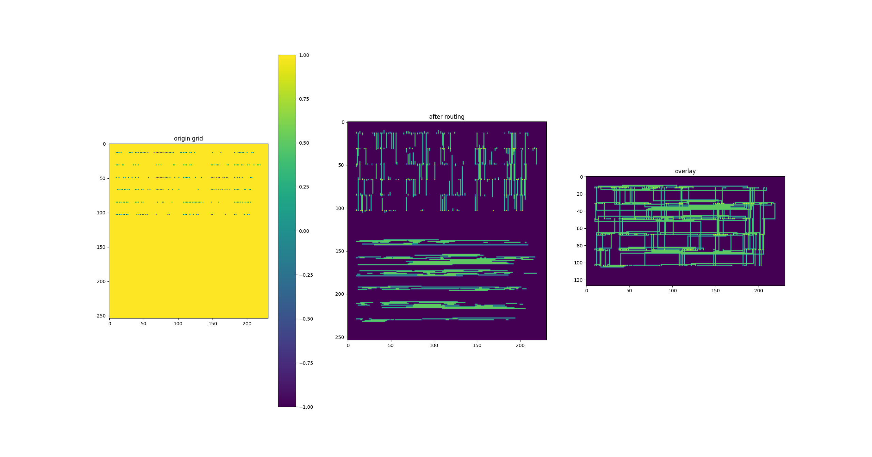
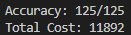
Results
grid
basic algorithm
fract2
opt
overlay
13

Slide 14
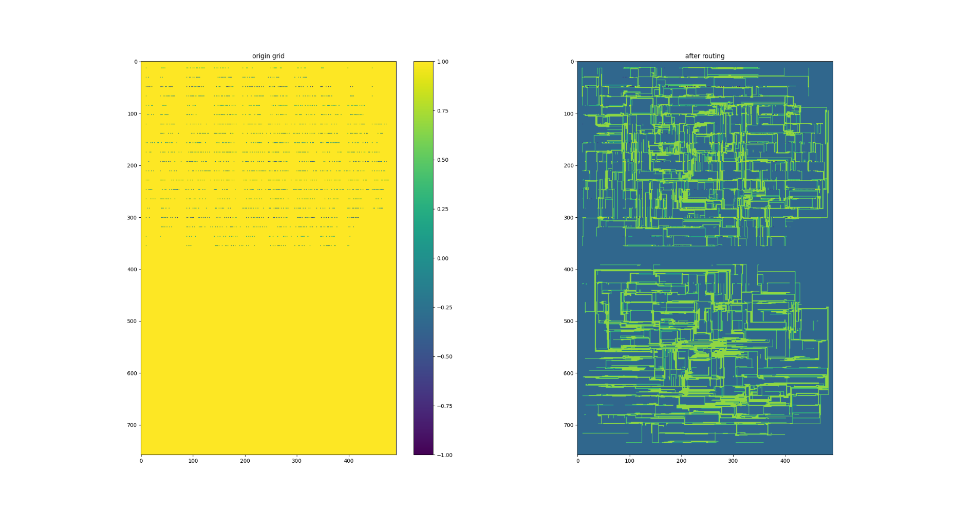
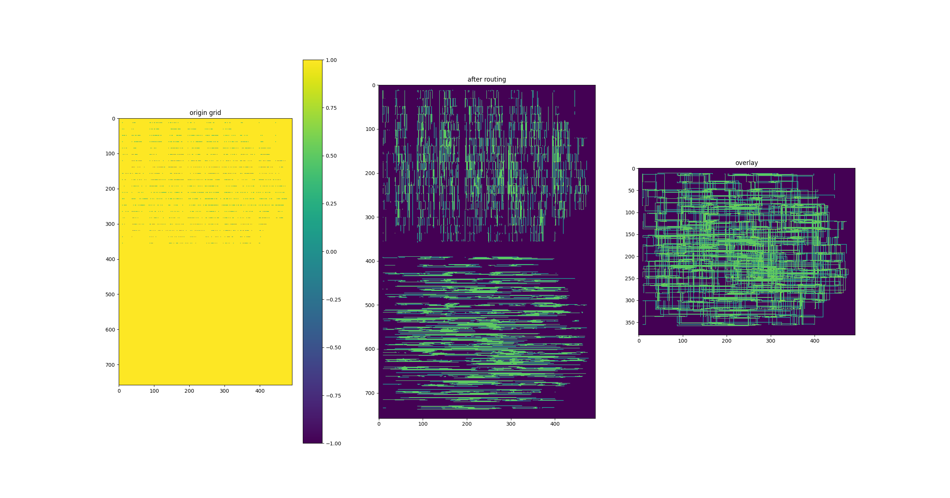
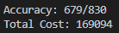
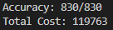
Results
primary1
grid
basic algorithm
opt
overlay
14

Slide 15
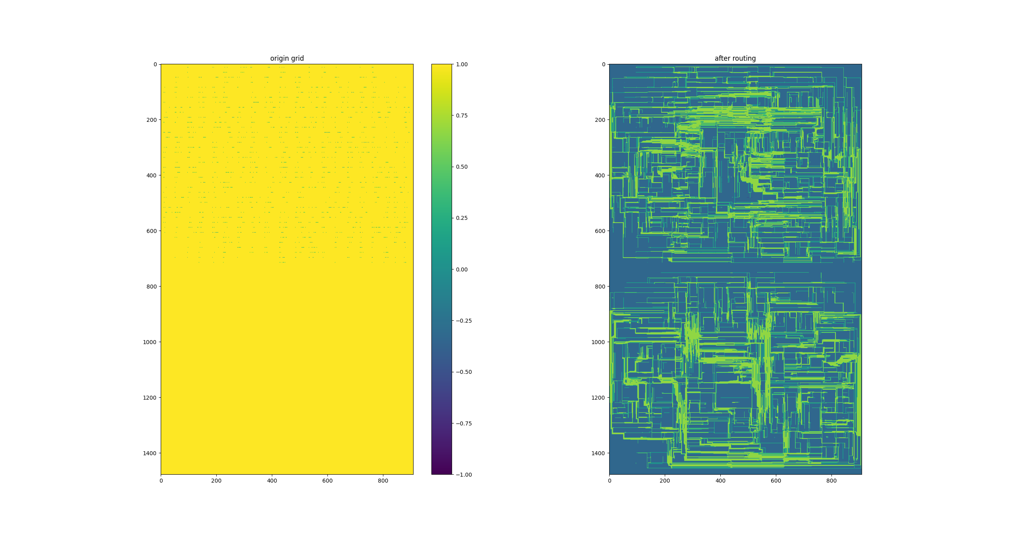
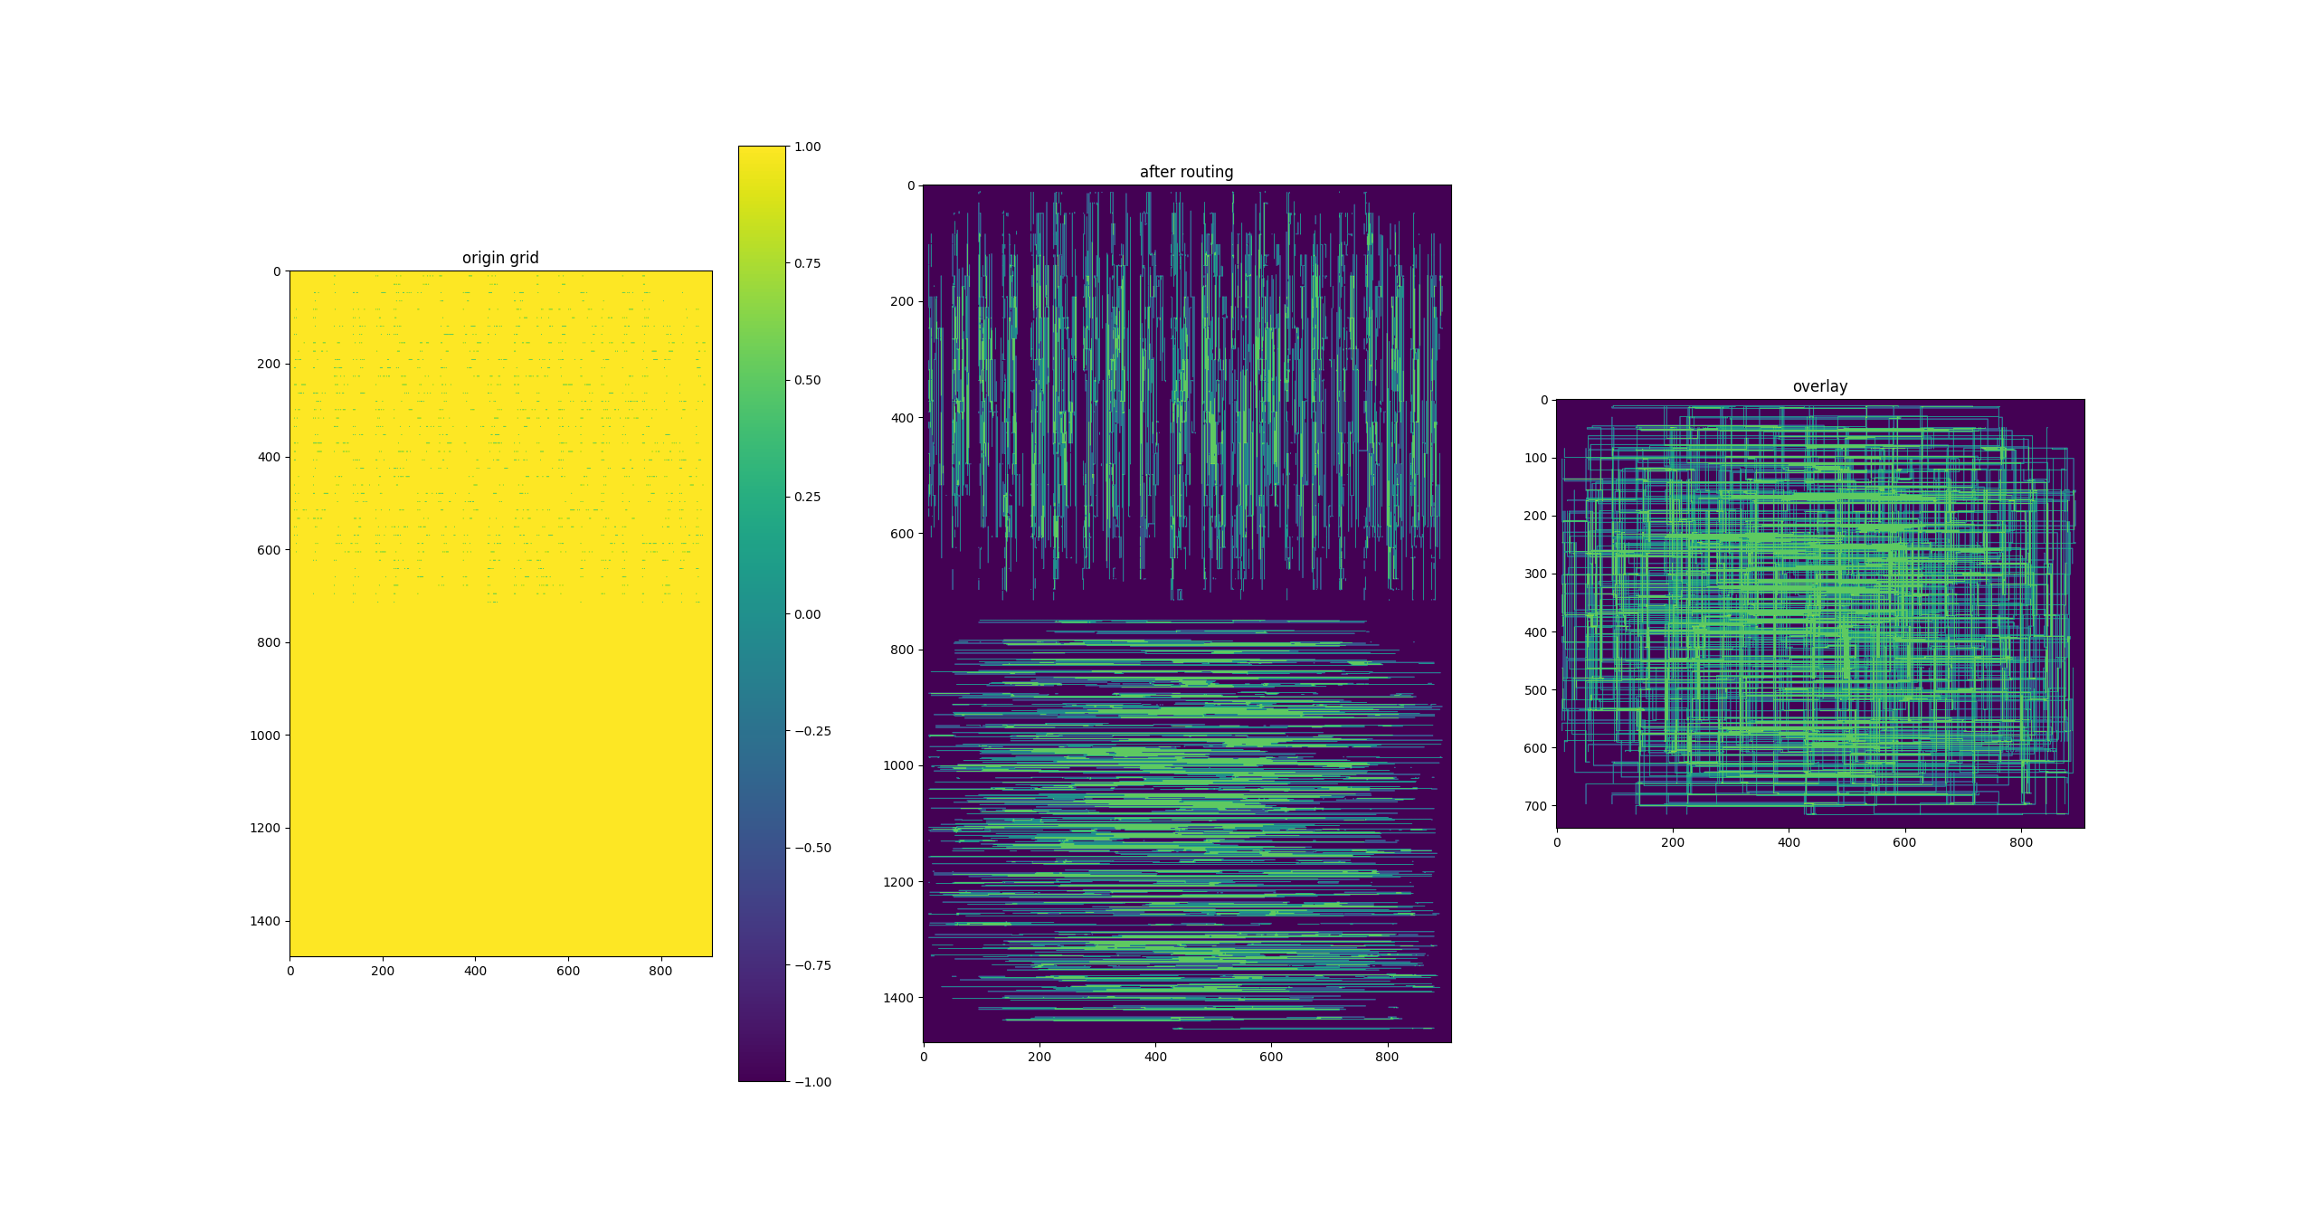
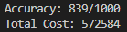
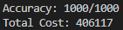
Results
industry1
grid
basic algorithm
opt
overlay
15

Slide 16
Results
 | Accuracy | Accuracy after Opt | Cost | Cost after Opt
bench1 | 20/20 | 20/20 | 352 | 372
bench2 | 20/20 | 20/20 | 3110 | 1760
bench3 | 16/16 | 16/16 | 1279 | 479
bench4 | 15/15 | 15/15 | 1793 | 1793
bench5 | 86/128 | 128/128 | 9433 | 12070
fract2 | 109/125 | 125/125 | 12142 | 11892
primary1 | 679/830 | 830/830 | 169094 | 119763
industry1 | 839/1000 | 1000/1000 | 572584 | 406117
16

Slide 17
THANKS

